Slide 1
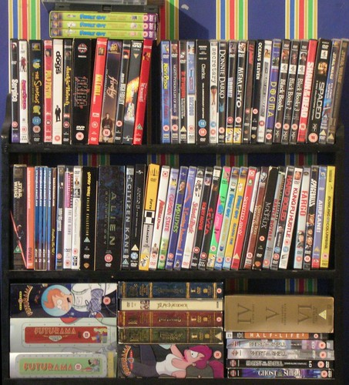
Detailed Analysis of the Revenue and Store Inventory Database

Slide 2
Performance Snapshot:-
Total Revenue:$67K +
Categories in inventory: 16
Inventory Size: 4.5k
Number of Stores: 2

Slide 3
The store's revenue from Australia and Canada was almost the same.

Slide 4
Almost all of the revenue /rentals were in 2005
In 2006, revenue was much less

Slide 5
Customers “KARL SEAL and ELEANOR HUNT” contributed the most to the Revenue

Slide 6
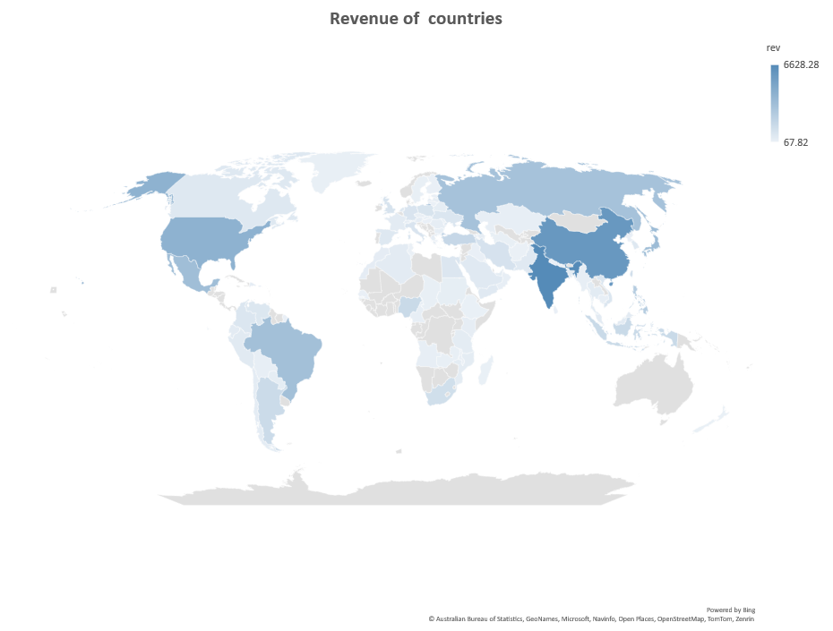
Revenue from India and China was high

Slide 7
The number of rentals in stores in Canada is slightly higher than that in Australia

Slide 8
In July and August, the films are rented the most

Slide 9
The highest number of Films available was of SUSAN DAVIS (54 films)
The number of films of VAL BOLGER,ANGELA WITHERSPOON ,UMA WOOD were SAME(35 films)

Slide 10
A “TRAVEL Film BUCKET BROTHERHOOD” was rented the most
A Foreign Film ROCKETEER MOTHER was the second most

Slide 11
“SPORTS and ANIMATION” are the top rented genre
Genres like HORROR, TRAVEL, MUSIC were rented low.

Slide 12
The Film “Telegraph Voyage” generated the highest Revenue

Slide 13
Parent Guidance under 13 years (PG-13) rating Film was the best-seller film

